Slide 1
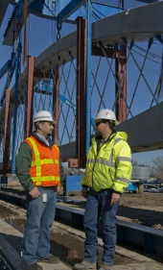
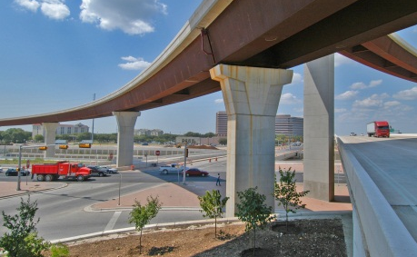
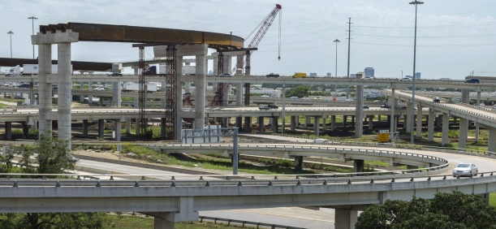
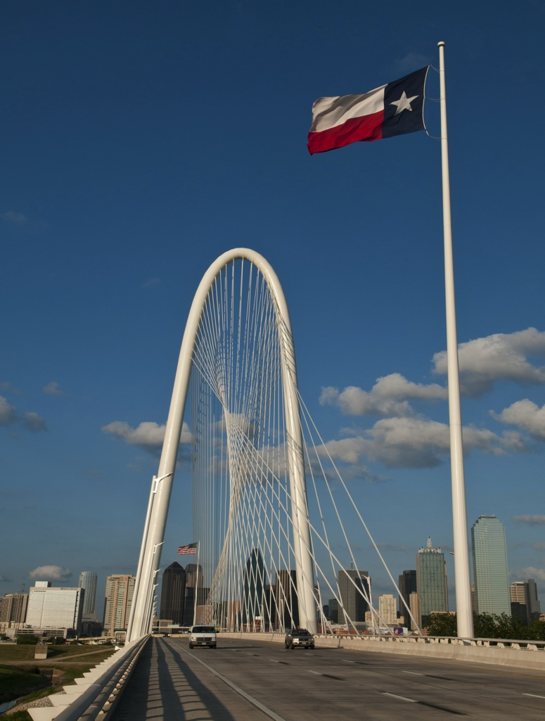
Accelerated BRIDGE CONSTRUCTION: TECHNIQUES
Kevin Pruski, PE – TxDOT Bridge Division
2019 ARDOT TRC Transportation Conference

Slide 2
Outline (ABC – “Accelerated Bridge Construction”):
1
Definition – with examples of rapid bridge construction
2
Prefabricated Elements
3
Modular Units
4
Lateral Slide-in Bridge Construction
5
Self Propelled Modular Transporters (SPMTS)
6
Pre-Construction Considerations
Post Construction
7
Self Propelled Modular Transporters (SPMTS)
8

Slide 3
What is Accelerated Bridge Construction “ABC”?
Definition:
  Optimizing concepts, materials, and construction techniques to reduce the time to replace/build a bridge.
  Getting the contractor to build a bridge faster than usual minimizing disruption to traffic.
Amount of time available dictates what methods need to be utilized.
Bridge construction projects can be built in less time (Reduce WD) provided clear direction in the plans is given and additional budget allowed.
  Identify a project where the bridge is on the critical path (justification).
  Will exclude some contractors because of more staffing required.
  Not ideal. Maybe early advertising of 30% & 60% plans will help allow contractor staffing and equipment utilization (Include rough time estimates in early release of plans for scrutiny).
Pursue other options to speed construction.

Slide 4
Rapid Bridge Construction – Example 1
IH 40 WB at FM 2381 (AMA-Bushland)
  Bridge severely damaged by truck fire under bridge
  Traffic partially restored on IH 40 WB and FM 2381 Opened
  EMC Project let at $591,000
  Decided replacing bridge better option
Timeline
  2/27/2017 – Damaged/Closed
  3/22/2017 – EMC to Repair
  6/07/2017 – Construction project let to Replace
  8/19/2017 – Roads Closed – Bridge Demoed/Const. Began
  10/11/2017 – Interstate and FM 2381 Reopen
$1.4 million total contract cost for entirely new bridge ($150/SF total bid)

Slide 5
Rapid Bridge Construction – Example 2
FM 849 over IH 20 (TYL – Lindale)
  Bridge severely damaged by over-height vehicle on IH 20
  Closed – November 14, 2017
  $450,000 Estimate to repair – Plans already on shelf for wider replacement bridge. Keep closed and replace by EMC.
Timeline
  11/14/2017 – Damaged/Closed
  11/25/2017 – EMC to Replace (wider bridge)
  12/07/2017 – Construction began
  12/8 to 12/10/2017 – Interstate Closed for Demolition
  03/27/2018 – FM 849 Reopened
$4.6 million total contract cost ($2 million for bridge items ($105/SF))

Slide 6
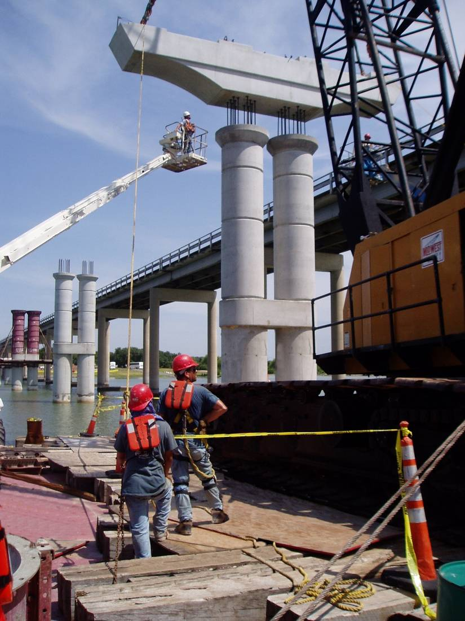
Prefabricated Elements (Tried and True Method)
Expand the use of what already works.
TxDOT’s primary technique for accelerated bridge construction (ABC).
In addition to increased speed, also typically comes with increased quality.
Can encompass practically every element from the ground up.
Accurate surveying critical.

Slide 7
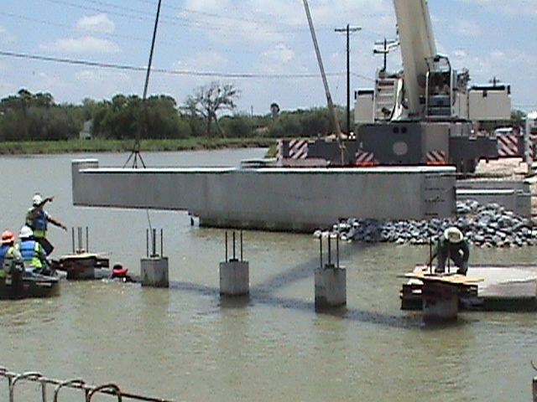
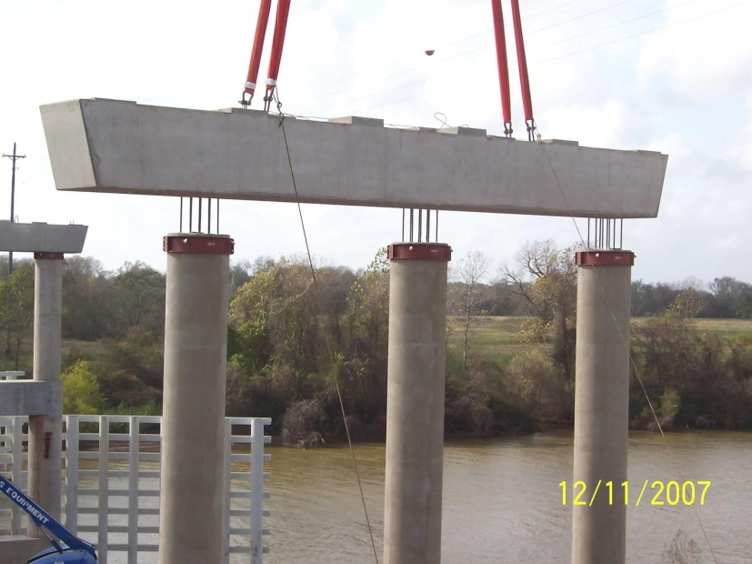
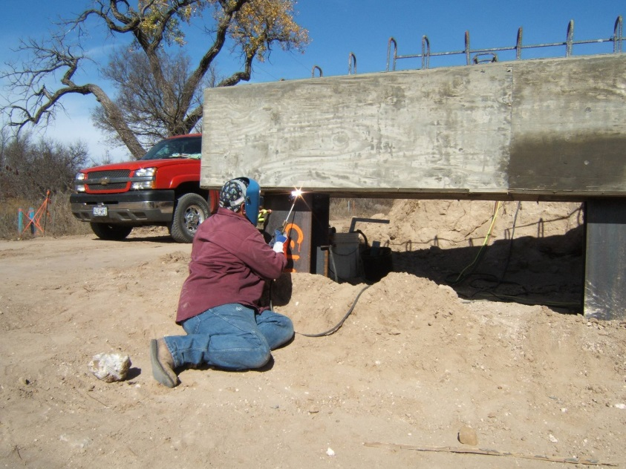
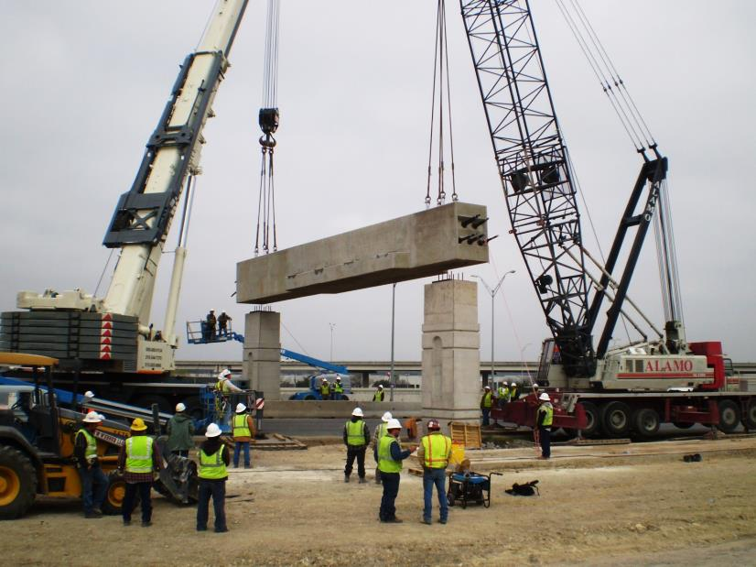
Precast Bent Caps

Slide 8
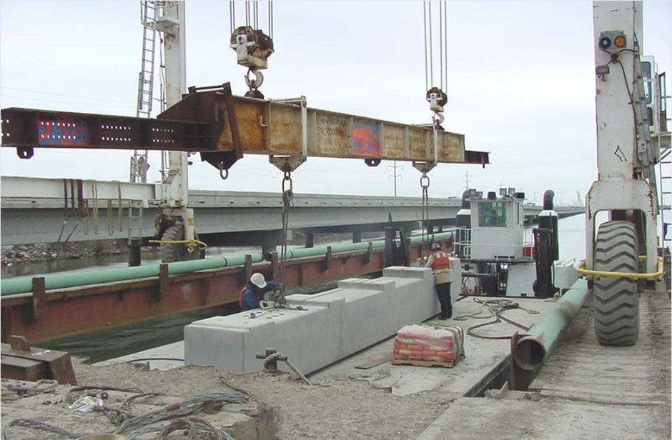
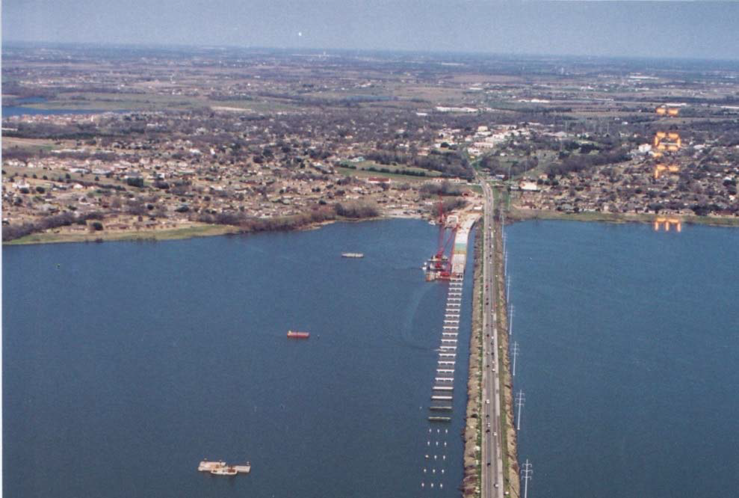
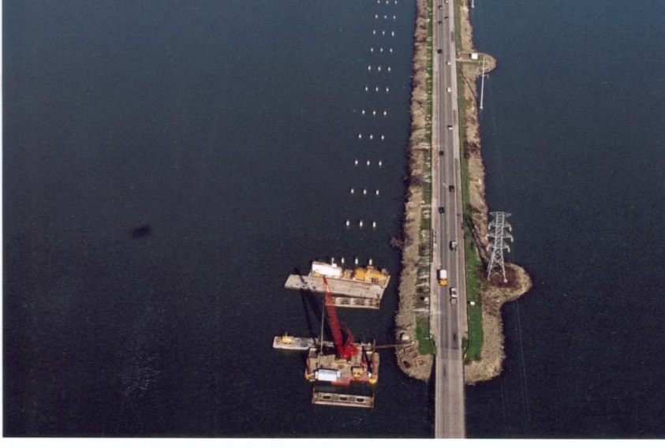
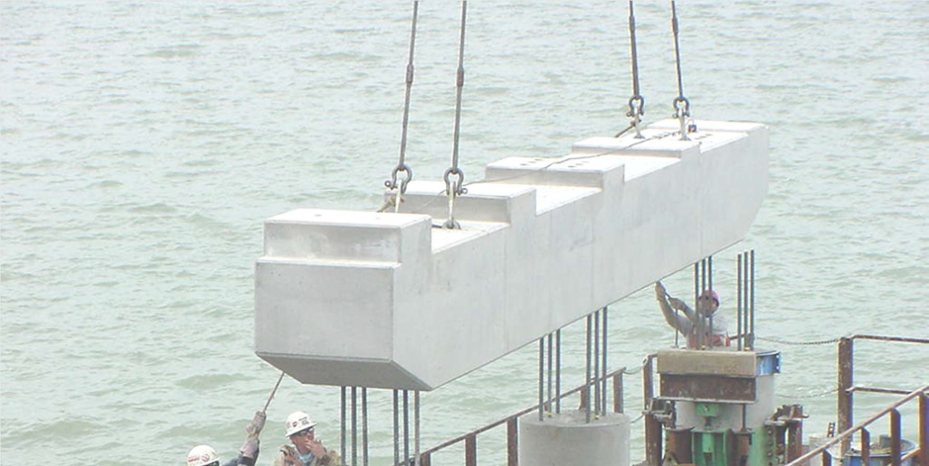
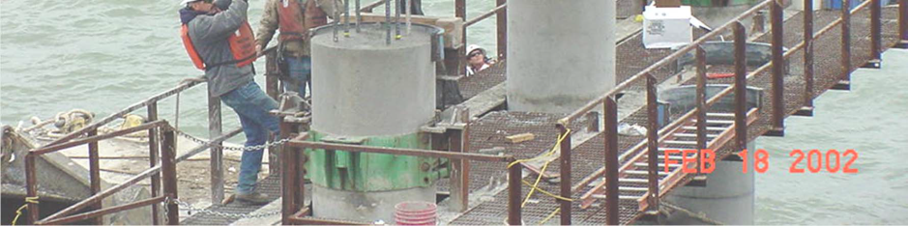
Precast Bent Caps – Long Water Crossings

Slide 9
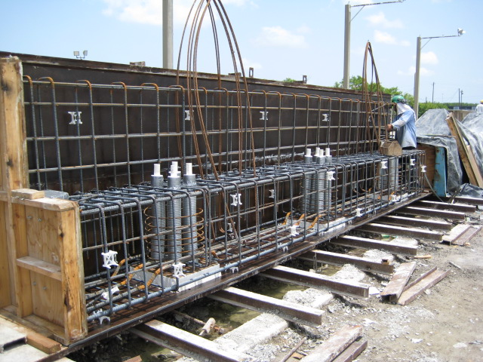
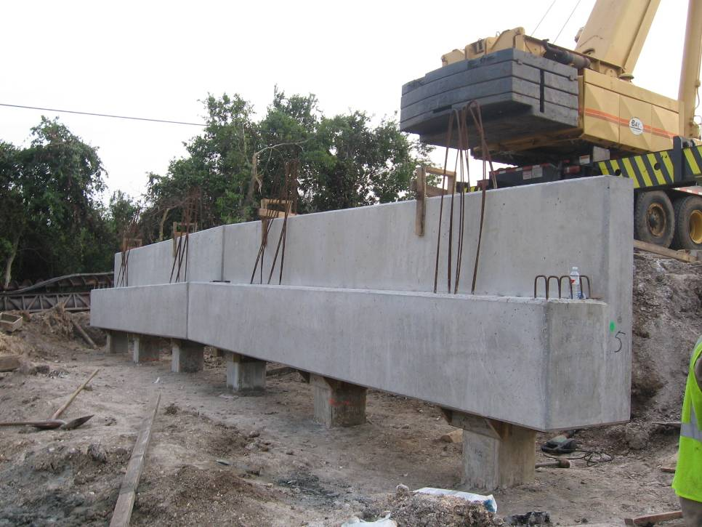
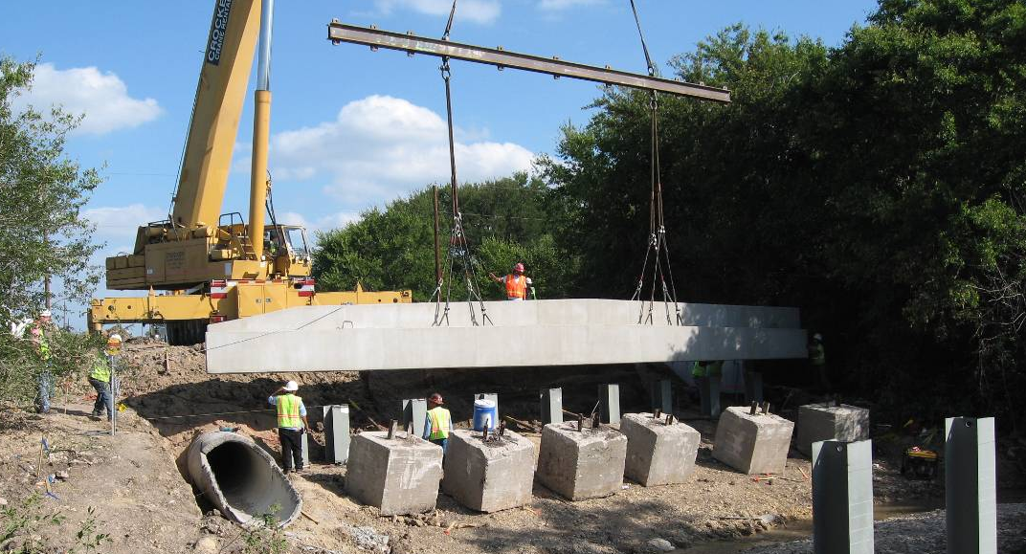
Precast Abutments

Slide 10
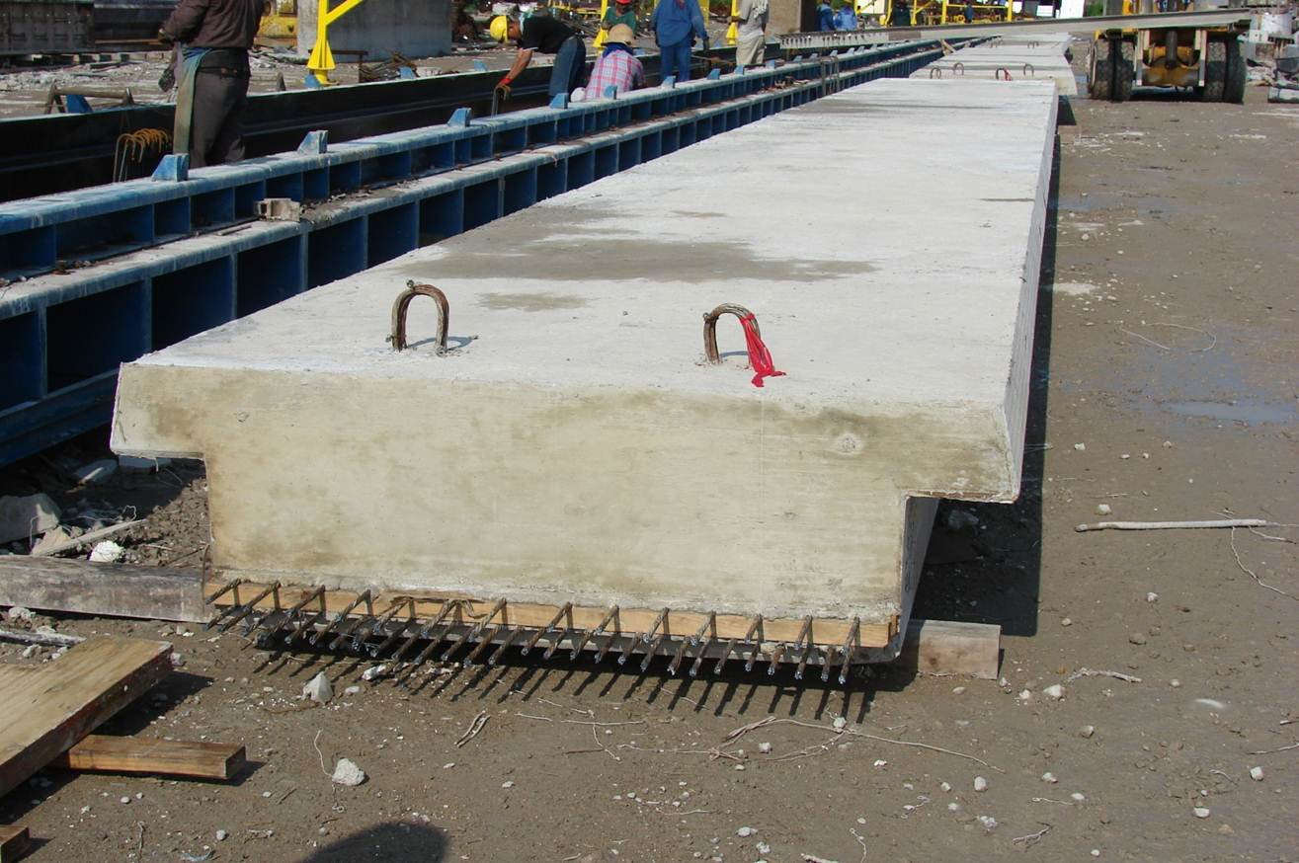
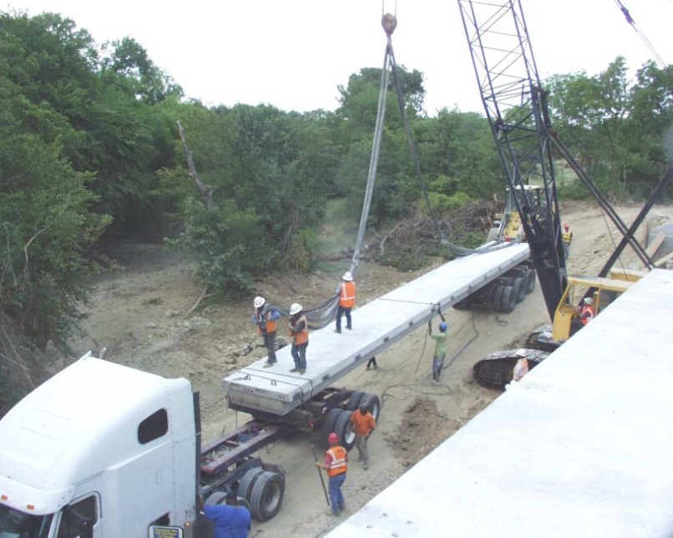
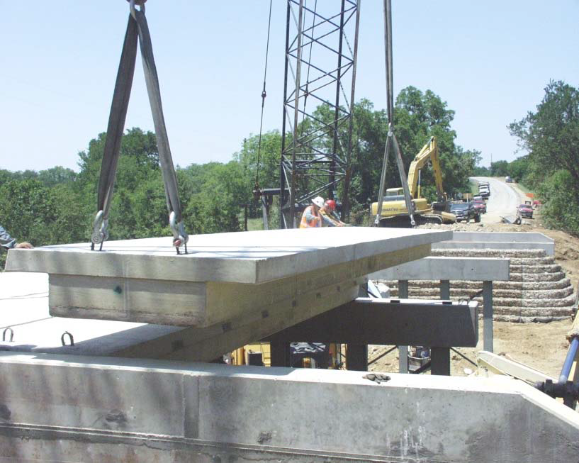
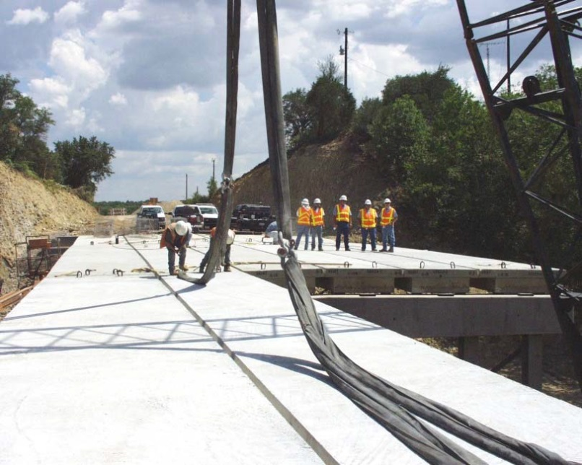
Decked Slab Beams

Slide 11
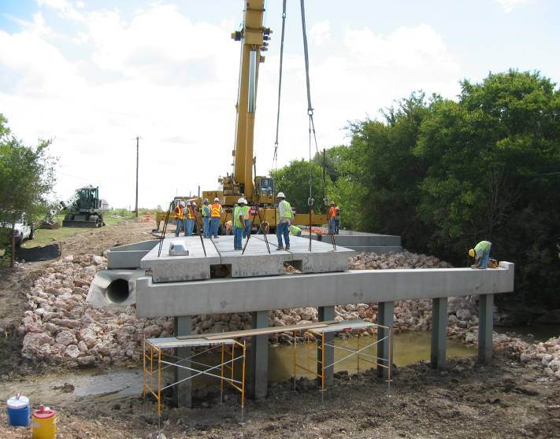
Decked Slab Beams: 6 – 10 Day Construction Projects
Precast Abutment
Decked Slab Beams
Precast Bent Cap
Steel Piling

Slide 12
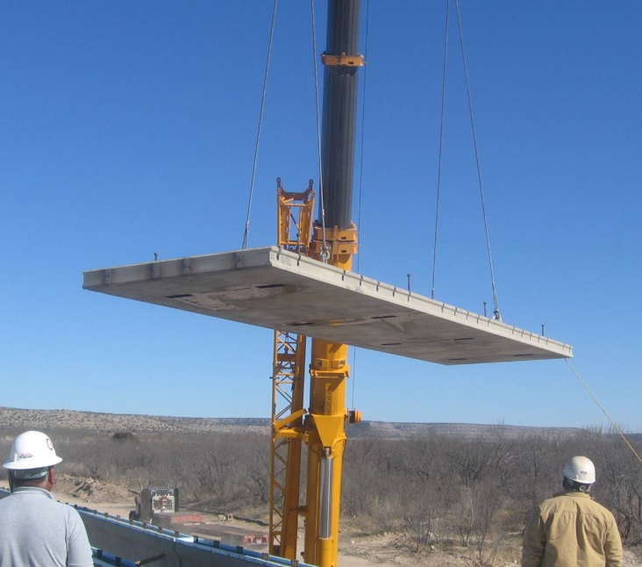
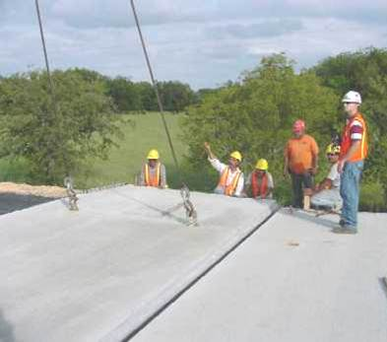
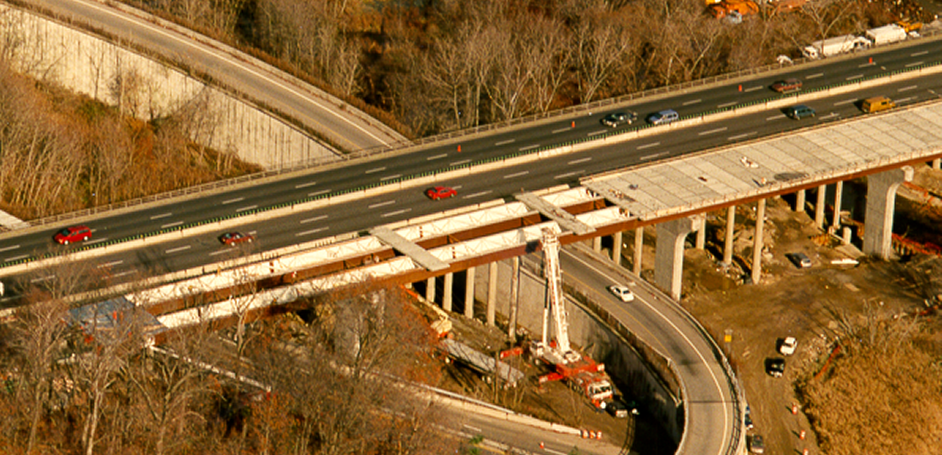
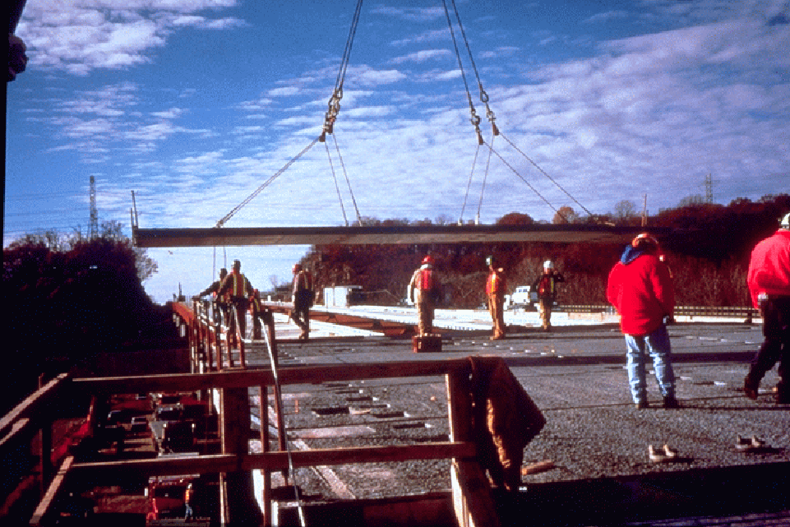
Full Width, Full Depth Panels

Slide 13
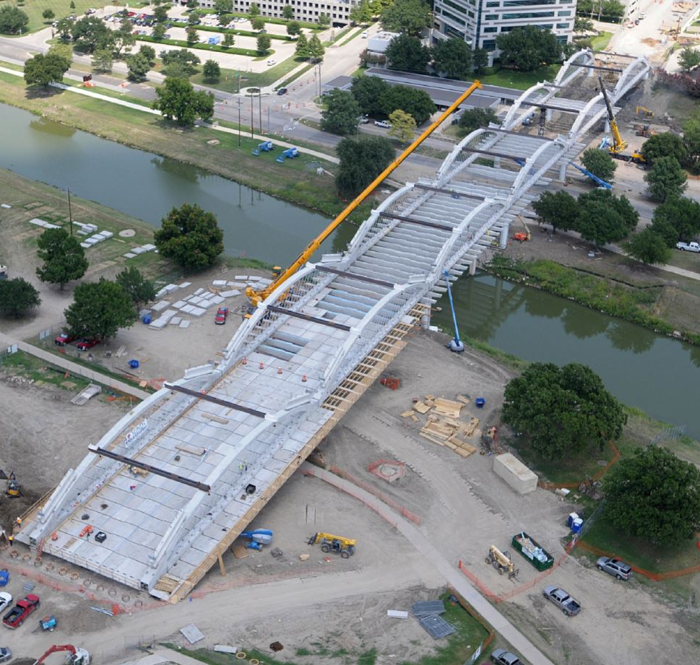
Taking Precast to the Extreme – West 7th Street
12 Precast
Arch Members
102 Precast
Floorbeams
3744 Precast
Sub-Deck Panels
Allowed 5 Months
of Total Closure
Finished 26 Days
Early

Slide 14
Alternate Prestressed Bent or Abutment Designs SOP
There is increasing interest in utilizing prefabricated elements in all facets of bridge design and construction.
Precast Alternate no included in the plans.
Developed a Standardized Method to allow Contractors to propose alternate to Cast-in-Place (CIP) Construction
http://ftp.dot.state.tx.us/pub/txdot-info/brg/design/alt-prestressed-bent-abutment.pdf

Slide 15

Alternate Prestressed Bent or Abutment Designs SOP
Step 1: Contractor submits request to District for alternate design concept, including justification for the benefit to TxDOT.
Step 2: If request is approved, Contractor develops alternate design package (plans and design calculations).

Slide 16
Alternate Prestressed Bent or Abutment Designs SOP
Step 3: TxDOT Project Manager sends request for approval to the original Engineer of Record.
  If a consultant, review is paid for under the Construction Phase Services.
  If contract does not include Construction Phase Services, TxDOT Bridge Division will review.
Step 4: Reviewer stamps the plans. If marked “Return for Corrections” then the submittal process starts again.

Slide 17
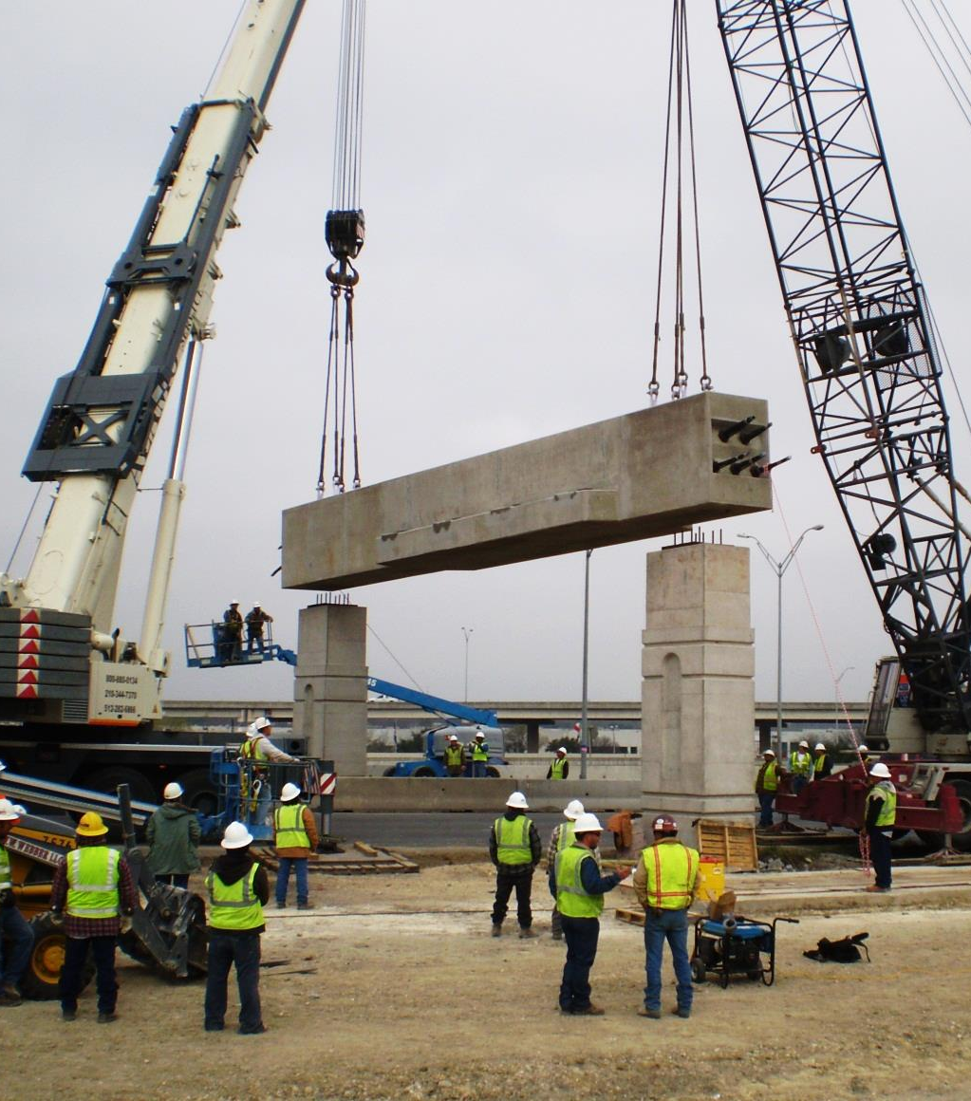
Alternate Prestressed Bent or Abutment Designs SOP
Step 5: If approved, TxDOT notifies Contractor. Alternate plans are filed with contract plans so the as-builts are accurate.
Step 6: Contractor submits shop plans. TxDOT District PM forwards to the appropriate party for review.
Step 7: Prestressed bents are fabricated and erected, and everyone rejoices.

Slide 18
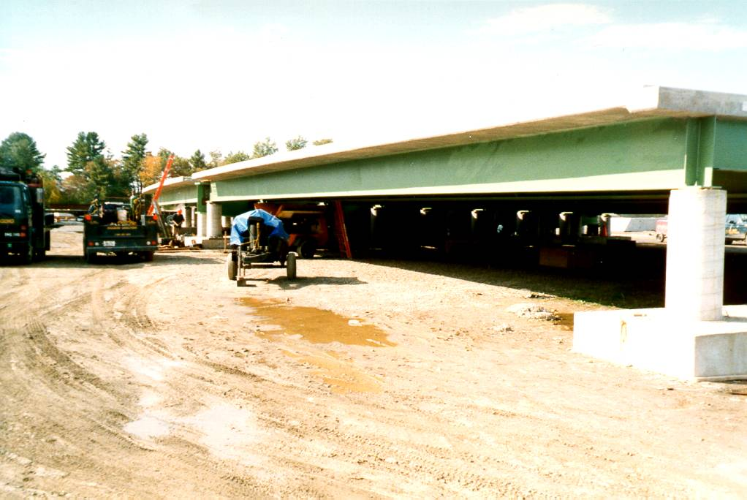
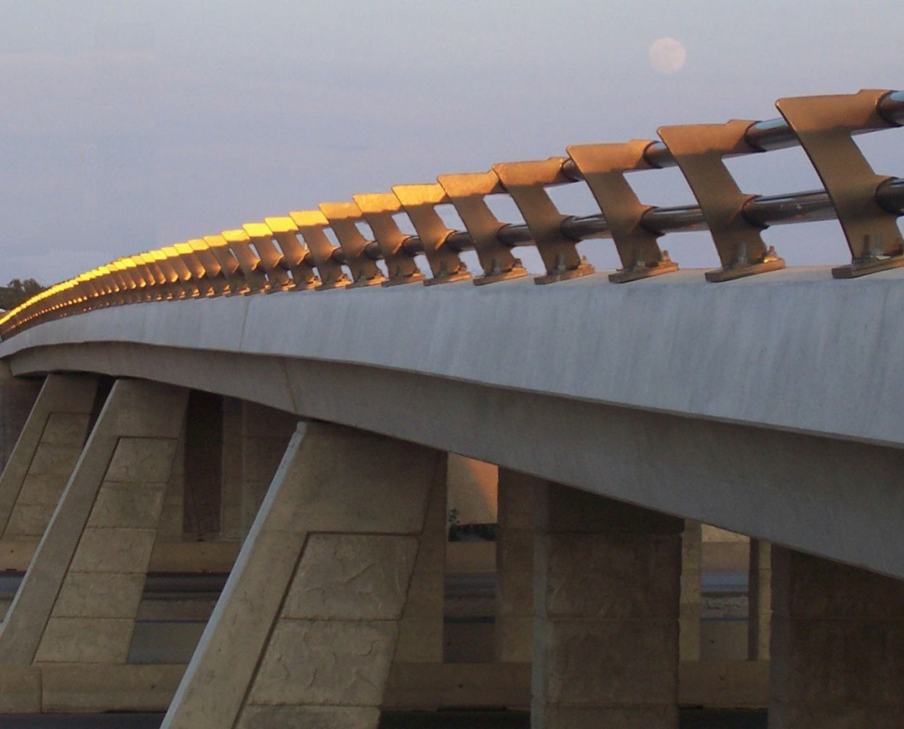
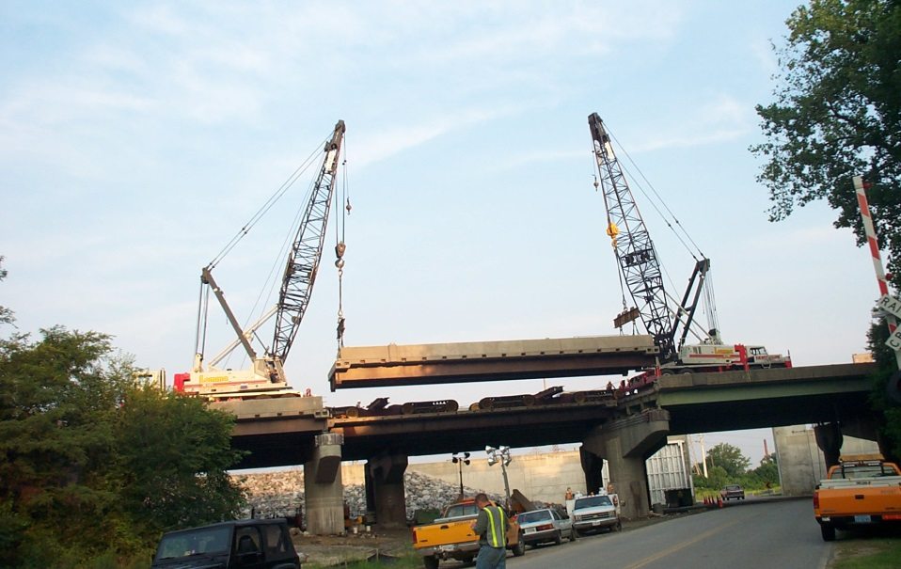
Modular Units
Construct sections of bridge off site.
Close road fully or partially. Demo in phases, and bring in sections.
Splice it all together.
WAC used on SH6 over IH35
  Precast/Pretopped U-Beams
  Cast offsite to match cross-slope

Slide 19
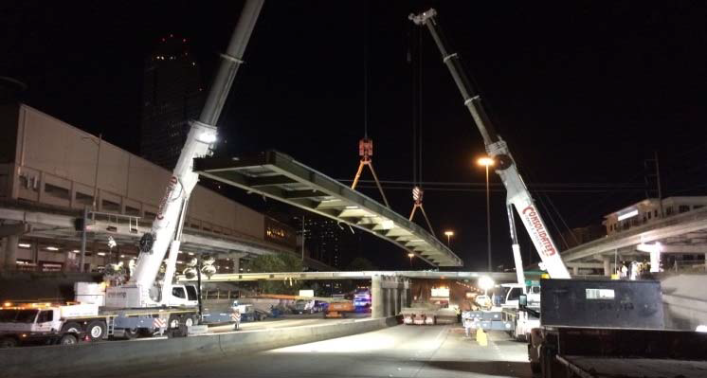
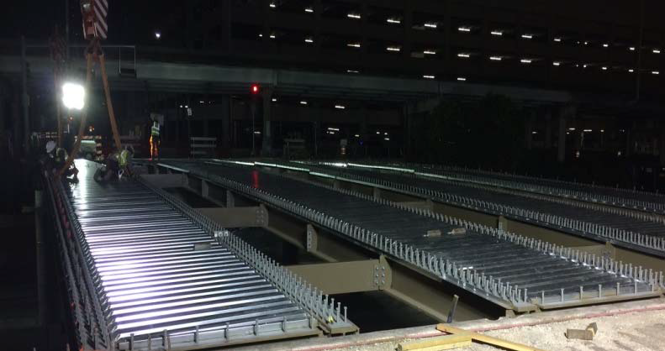
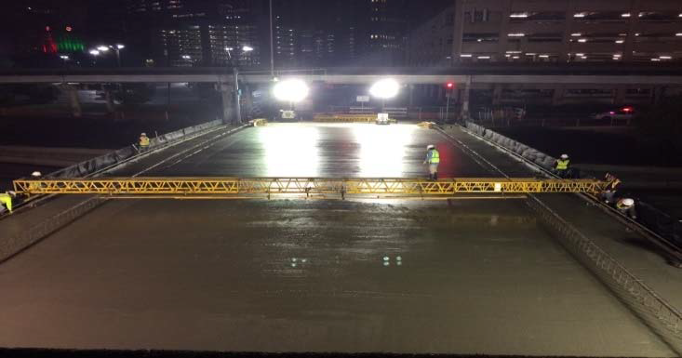
Modular Units – West Dallas St. in Houston
Time Line:
09/02/2016: Damaged and Closed
11/04/2016 (Weekend): Bridge Demolition
11/08/2016 (Weekend): Steel Modules Erected
12/05/2016 (Night): Deck Placement
12/09/2016 (Weekend): Overhang form removal & misc.
12/16/2016: Bridge Reopened

Slide 20
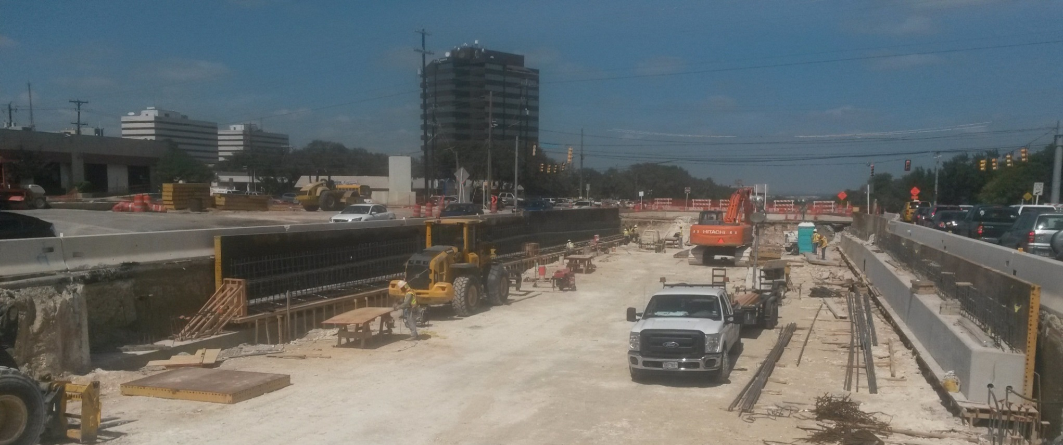
Lateral Slide-in – LP 345 (San Antonio)
Build bridge adjacent to existing bridge.
Demo existing (Excavation of road in this case).
Slide new bridge in place over the weekend.

Slide 21
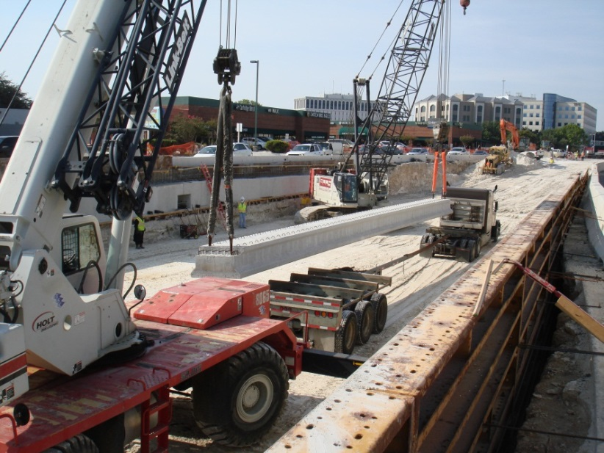
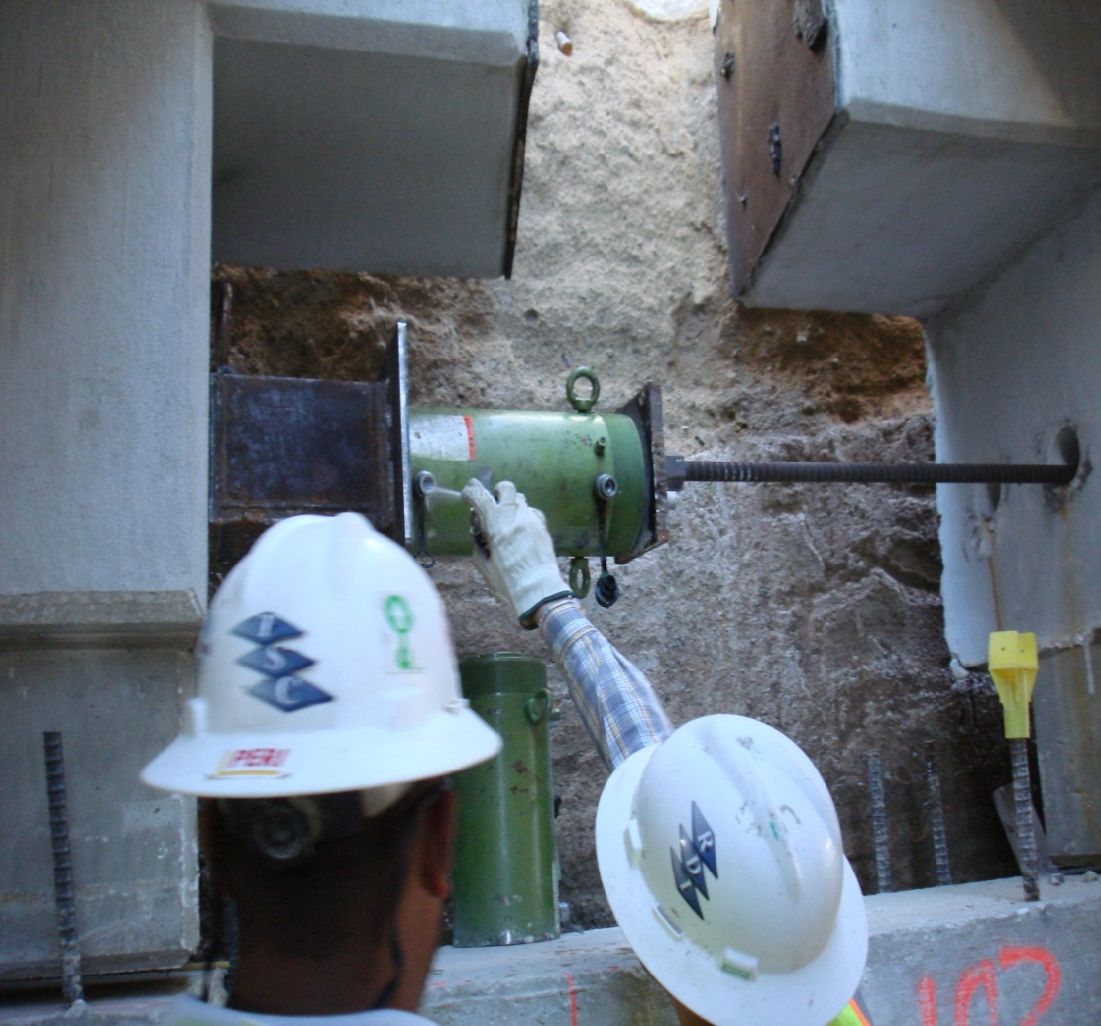
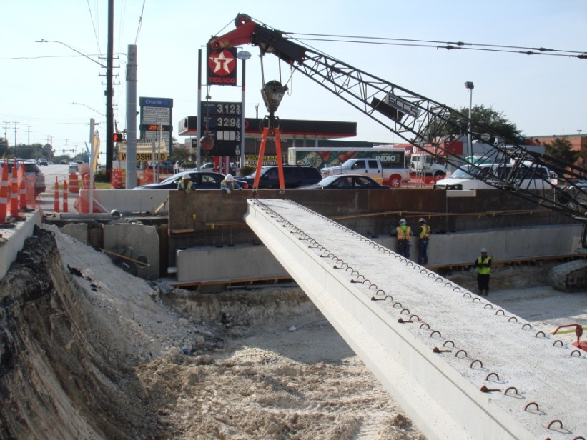
Lateral Slide-in – LP 345 (San Antonio)

Slide 22
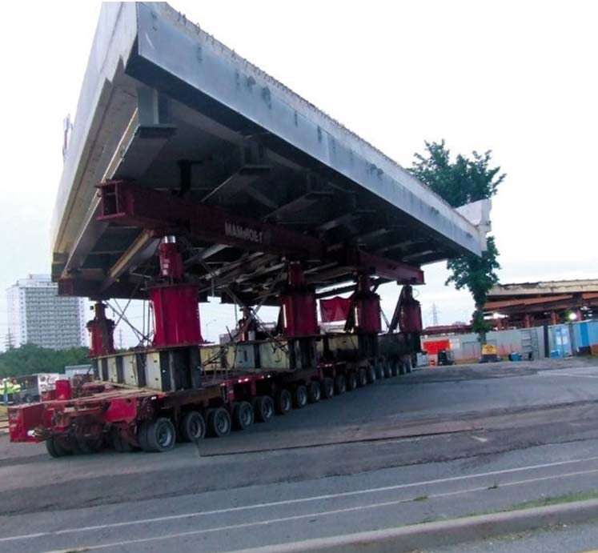
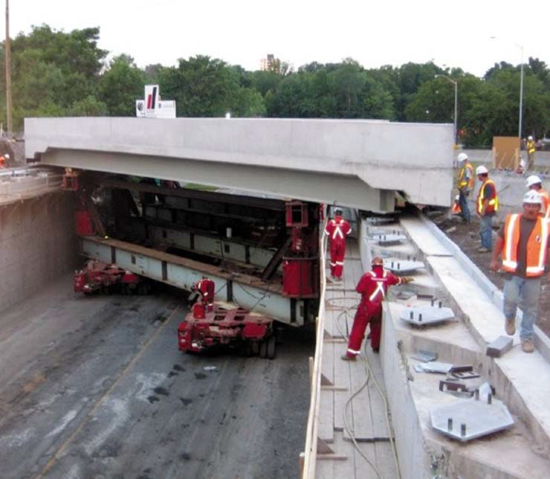
Self Propelled Modular Transporters (SPMT)
Photos Courtesy of Heavy Equipment Guide
Build the spans off site.
Close the road, demo the existing, move new into place.

Slide 23
Pre-Letting Activities
Decide What is Tolerable Related to Traffic Control and Length of Closures (Every hour of a closure is very valuable for construction)
Community involvement
Consider possible staging locations and what is feasible
Advertise early the plans for ACG/Contractor Review and Comment
Include options within contract to allow contractor innovations/alterations?
Consider having Pre-bid Meeting – Probably a good idea
Start/continue the education of project personnel. Staff with considerable understanding of project essential to successful ABC project.

Slide 24
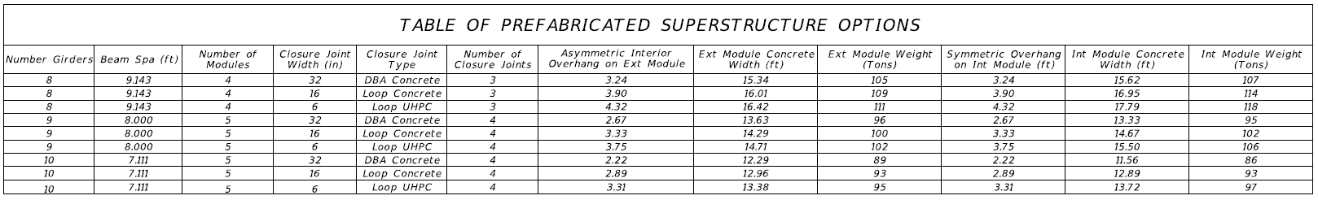
Section Weights and Widths – Modular Units (DAL Project)
Guidance from AGC:
  Maximum desirable transportable load over long distance ~ 100 Tons
  Maximum desirable lift load (assuming two crane lift) ~ 150 Tons
Widths over 10 – 12 ft become problem for long distance transportation

Slide 25
Pre-Construction- Contractor Submittals
Fabrication Drawings and Procedures
  Item 424 (Precast Fabrication)/DMS-7300
    Multi-project Fabrication Plant
    Project Specific Fabrication Plant
  Item 441 (Steel Fabrication) (Do we need a Special Provision)?
    DMS-7370 Considerations

Slide 26
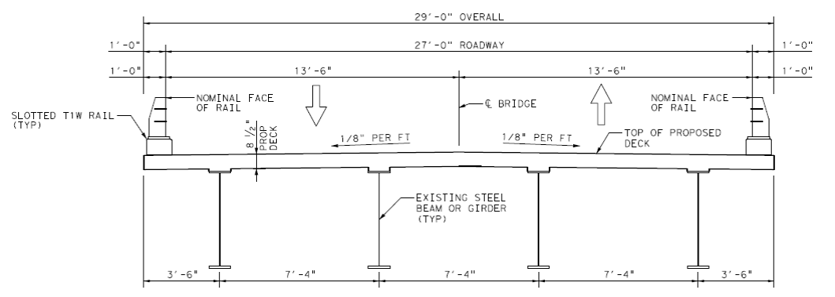
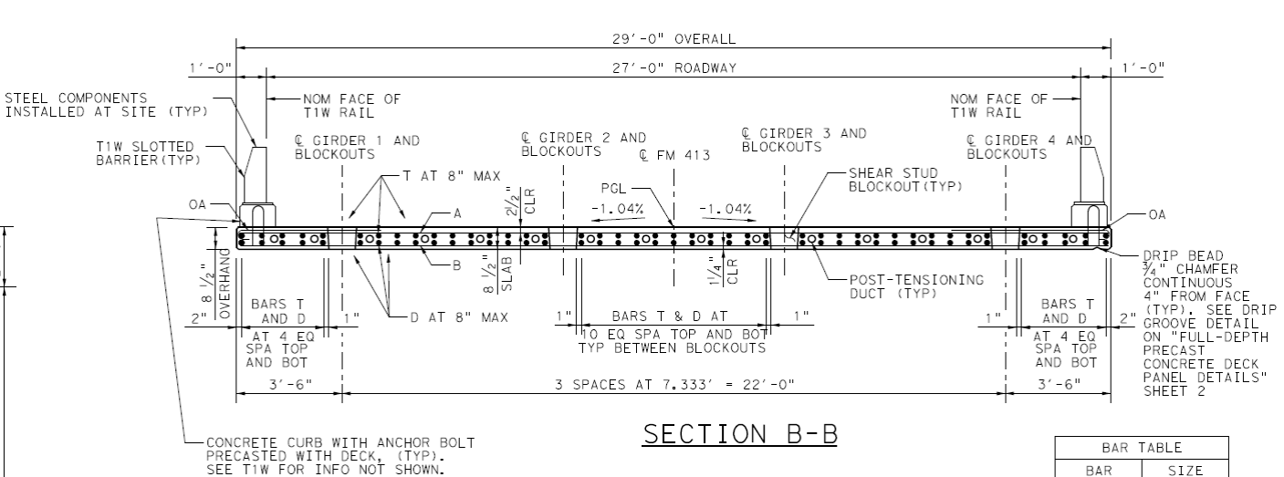
Full Width, Full Depth Panels – WAC Project
Bridge Summary:
671’ Long
9 Spans
470’ Main Unit
63 Precast Panels
Normal Reinforcing
Post-tensioned together
$16/SF Deck Removal
$44/SF Deck
$13/SF Rail

Slide 27
Pre-Construction- Contractor Submittals
Fabrication Drawings and Procedures
  Item 424 (Precast Fabrication)/DMS-7300
    Multi-project Fabrication Plant
    Project Specific Fabrication Plant
  Item 441 (Steel Fabrication)
Erection/Construction Procedures
  Item 5, Table 1 Requirements
  Item 7.16 “HAULING AND LOADS ON ROADWAYS AND STRUCTURES”

Slide 28
Cranes, Cranes and Where to Place Them

Slide 29
Pre-Construction- Contractor Submittals
Fabrication Drawings and Procedures
  Item 424 (Precast Fabrication)/DMS-7300
    Multi-project Fabrication Plant
    Project Specific Fabrication Plant
  Item 441 (Steel Fabrication)
Erection/Construction Procedures
  Item 5, Table 1 Requirements
  Item 7.16 “HAULING AND LOADS ON ROADWAYS AND STRUCTURES”
Material Information
  Concrete Mix Verification (Note Standard Specification is just that – Standard Construction – For ABC explore Special Provisions/Specifications to Reduce Time)
  “Mock-up” requirements
  Different materials and everybody needs to be brought up to speed

Slide 30
Longitudinal Closure Pours Options (Different Concretes)
Loop Concrete Joint
  Wider closure pour
  Rapid setting concrete with steel fibers
UHPC Joint
  Narrow longitudinal closure pour
  Utilize Ultra-high Performance Concrete
  Problem: UHPC is slow to get full strength

Slide 31
During Construction
Pre-plan everything
Verify Survey Data
Utilize Concrete Maturity Method for Construction Processes
Account for dimensional tolerance of pieced together members
Take notes and review work
Call for support (Have key phone numbers for SME’s)
Rapid Decision Making Essential

Slide 32
Post-Construction Close-out
What went wrong?
  How was it addressed?
  What was the impact
What went well?
  Why did it go well?
  How can the success be carried forward to other projects?
What would change if done again?
  Save time
  Lower costs

Slide 33
Summary
Accelerated Bridge Construction (ABC)
  Many Options
  Ask for contractor input
  Allow for innovations
Community Involvement
  Promote ABC as a less disruptive (in time) alternative
  Get in, Get out, Stay out (fulfill that motto by great execution of work)
Thorough Planning
Great Communication Key to Success

Slide 34

Questions?
For More Information related to ABC:
https://www.fhwa.dot.gov/bridge/abc/
https://abc-utc.fiu.edu/

Slide 35
Copyright Notice
Copyright 2019 • Texas Department of Transportation • All Rights Reserved
Entities or individuals that copy and present state agency information must identify the source of the content, including the date the content was copied. Entities or individuals that copy and present state agency information on their websites must accompany that information with a statement that neither the entity or individual nor the information, as it is presented on its website, is endorsed by the State of Texas or any state agency. To protect the intellectual property of state agencies, copied information must reflect the copyright, trademark, service mark,
or other intellectual property rights of the state agency whose protected information is being used by the entity or individual. Entities or individuals may not copy, reproduce, distribute, publish, or transmit, in any way this content for commercial purposes. This presentation is distributed without profit and is being made available solely
for educational purposes. The use of any copyrighted material included in this presentation is intended to
be a “fair use” of such material as provided for in Title 17 U.S.C. Section 107 of the U.S. Copyright Law.

